Slide 1
Is any place for urinary derived gonadotrophins in ART?
Prof dr Nebojsa Radunovic
Sibenik 17.05.2014

Slide 2
History
first generation of gonadotrophins, used in the 1970’s, was human menopausal gonadotrophin (hMG)
produced from the urine of menopausal women
combination of follicle stimulating hormone (FSH) and luteinizing hormone (LH) in a 1:1 ratio).

Slide 3
History
first hMG was approved in the USA 1970, for follicular development in anovulatory and oligovulatory women (Nichols et al., 2001)
It was obtained from urine of postmenopausal women (contains both FSH and LH in high concentrations)
Alternative to hMG became available in US 1987 in form of human urinary FSH largely purified of LH and was still administered by the i.m. route.
it remained mainstay of fertility treatment for almost 20 y
Notes:
Historical developments
The frst hMG was approved in the United States in 1970, for follicular development in anovulatory and oligovulatory women (Nichols et al., 2001). It remained the mainstay of fertility treatment for almost 20 years.
This product was obtained from the urine of postmenopausal women. Postmenopausal urine contains both FSH and LH in high concentrations.
hMG, indeed, consists of approximately one half FSH and LH, though intermixed with a relatively high concentration of co-purified urinary proteins.
Until recently, hMG was administered exclusively by i.m. injection. Its clinical efficacy in achieving ovulation, or so-called `controlled ovarian hyperstimulation', has been established beyond any reasonable doubt (Lunenfeld et al., 1962; Tsapoulis et al., 1978; Goldfarb et al., 1982) and pregnancy rates of ~11.7% per;Bug Workaround; ;Bug Workaround; treatment cycle have been reported in the literature (Lunenfeld
and Lunenfeld, 1997). In combination with intrauterine inseminations (IUI), they may approach 15% (Gleicher and Karande, 2000).
; Bug Workaround;

Slide 4
History
Since 1980’s (second generation), a variety of urinary gonadotrophins have been produced, such as purified FSH(FSH-P) which contains less than one international unit (IU) of LH per 75 IU of FSH
Third generation of urinary gonadotrophins was highly purified FSH (FSH-HP) with less than 0.1 IU of LH per 75 IU of FSH.

Slide 5
History
Fourth generation of gonadotrophins was produced using recombinant DNA technology (rFSH), which is free from LH activity.
Production of rFSH is independent of urine collection, thus guaranteeing a high availability of a biochemically pure FSH preparation that is free from urinary protein contaminants.
Process also yields FSH with minimal batch-to-batch discrepancy and low immunogenicity which allows subcutaneous administration.

Slide 6
History
The last decade of the 20th century witnessed a potential milestone in the treatment of infertility as previously urine derived gonadotrophins were increasingly replaced by gonadotrophins produced through recombinant technologies.
These newer gonadotrophins are, however, more expensive, especially since urinary gonadotrophins, in principle, have come off patent protection and can now be offered under generic pricing structures.

Slide 7
Introduction
More costly pricing, however, does not necessarily indicate increased treatment costs.
If more expensive medications improve treatment cycle outcomes, treatment cost per established pregnancy may, indeed, be unaffected or even reduced.

Slide 8
Prion transmission in blood and urine: what are implications for recombinant and urinary derived gonadotrophins?
Human Reproduction Vol.17, No.10 pp. 2501–2508, 2002
Production of human menopausal and recombinant gonadotrophin preparations for use in ovarian stimulation protocols in fertility needs to ensure that safety of such drugs remains as high as ever.
Recombinant preparations utilize fetal calf serum or other animal sera or proteins as part of a culture medium during production.
Human urinary-derived menotrophin preparations are exposed to theoretical risk of infection from menopausal donors of urine

Slide 9
Bye-bye urinary gonadotrophins? Recombinant FSH:
A real progress in ovulation induction and IVF?*
Norbert Gleicher, Mary Vietzke and Andrea Vidali
Human Reproduction Vol.18, No.3 pp. 476±482, 2003
Recombinant gonadotrophin products do, indeed, represent progress for routine ovulation induction and IVF cycles.
Safety considerations favour recombinant products, while overall outcome and cost considerations favour urinary gonadotrophins.
Outcome, appears to differ, based on age and ovarian function, with younger patients benefiting from the FSH/LH combination offered by urinary products, while older women and young women with ovarian resistance, apparently benefting from pure FSH stimulation.

Slide 10
Bye-bye urinary gonadotrophins? Recombinant FSH:
A real progress in ovulation induction and IVF?*
Norbert Gleicher, Mary Vietzke and Andrea Vidali
Human Reproduction Vol.18, No.3 pp. 476±482, 2003
Young women with poor ovarian reserve may be best stimulated with a pure FSH/ antagonist protocol.
Conclusion: under current pricing structures in the US recombinant gonadotrophins do not represent a major progress for the treatments of ovulation induction and IVF.
They, however, allow for an improved selectivity of stimulation protocols.
The creation of recombinant FSH/LH products and cost adjustments for recombinant products, may affect these conclusions in favour of recombinant products.

Slide 11
Impact of highly purified urinary FSH and recombinant FSH on haemostasis: an open‐label, randomized, controlled trial
Human Reproduction Volume 19, Issue 4 Pp. 838-848, 2004
G. Ricci R. Simeone C. Pozzobon S. Guarnieri A. Sartore R. Pregazzi S. Guaschino
CONCLUSIONS:
Ovarian stimulation with recombinant FSH does not influence coagulation and fibrinolysis significantly, as already reported for urinary gonadotrophins.
The moderate changes induced by both treatments are no longer detectable after 4 weeks.

Slide 12
Sistematic review
Several systematic reviews compared recombinant gonadotrophin with urinary gonadotrophins (HMG, purified FSH, highly purified FSH) for ovarian hyperstimulation in IVF and ICSI cycles and these reported conflicting results.
Each of these reviews used different inclusion and exclusion criteria for trials

Slide 13
Systematic review
An early systematic review (Daya 1995) reported a higher clinical pregnancy rate per cycle with FSH-P and FSH-HP when compared with HMG
A later review (Agrawal 2000) reported no difference between these urinary gonadotrophin products.

Slide 14

2012

Slide 15
Latest & final review
Recombinant versus urinary gonadotrophin for ovarian stimulation in assisted reproductive technology cycles
2012
Madelon van Wely, Irene Kwan, Anna L Burt, Jane Thomas, Andy Vail, Fulco Van der Veen, Hesham G. Al-Inany

Slide 16
O B J E C T I V E S
To compare the effectiveness of recombinant gonadotrophin (rFSH)
with
three main types of urinary gonadotrophins (HMG, FSH-P & FSH-HP) for ovarian stimulation
in women undergoing IVF or ICSI treatment cycles

Slide 17
Main results
42 trial included with total of 9606 couples.
comparing rFSH to all other gonadotrophins combined, irrespective of the down regulation protocol used
did not result in any evidence of statistically significant difference in live birth rate
  *(28 trials, 7339 couples)

Slide 18
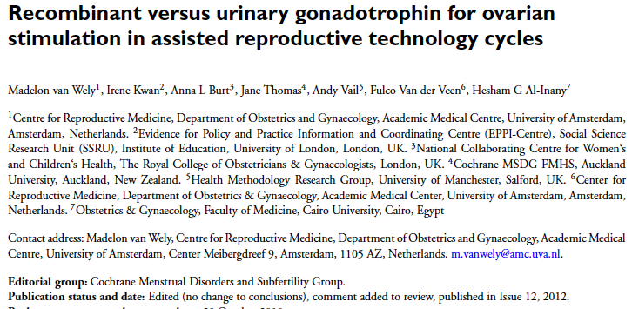
2012

Slide 19
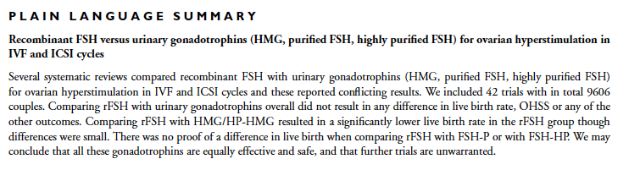
Differences were small. There was no proof of a difference in live birth when comparing rFSH with FSH-P or with FSH-HP.
We may conclude that all these gonadotrophins are equally effecive and safe, and that further trials are unwaranted

Slide 20
Differences were small. There was no proof of a difference in live birth when comparing rFSH with FSH-P or with FSH-HP.
We may conclude that all these gonadotrophins are equally effecive and safe, and that further trials are unwaranted

Slide 22
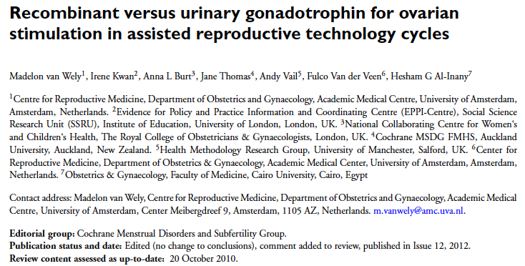

Slide 23
Cost considerations
of course, alone not determine which of the gonadotrophin products are to be used in preference.
Principal determining factor in any medical decision - making process is safety :
  to minimize potential risks
  to establish a risk / benefit ratio

Slide 24
Treatment decisions
are consequence of evaluations
sequential risk / benefit
  &
cost / benefit
always represent compromises

Slide 25
Historical developments
A final step in the purification of FSH was achieved when in the mid-1990s, recombinant FSH was introduced to the market.
Recombinant (r)FSH is in its amino acid sequence identical to human FSH, though carbohydrate side chain attachments cause pharmacodynamics, which do differ to some extent from human pituitary FSH
      (Prevost, 1998).

Slide 26
Recombinant versus urinary gonadotrophin for ovarian stimulation in assisted reproductive technology cycles

Slide 27
rFSH versus urinary gonadotrophins: primary analyses, Outcome 1 Live birth (or ongoing
pregnancy) by urinary gonadotrophin. . . . . . . . . . . . . . . . . . . . . . . . . . 102
Analysis 1.2. Comparison 1 rFSH versus urinary gonadotrophins: primary analyses, Outcome 2 Live birth (or ongoing
pregnancy) by down regulation protocol. . . . . . . . . . . . . . . . . . . . . . . . . 104
Analysis 1.3. Comparison 1 rFSH versus urinary gonadotrophins: primary analyses, Outcome 3 Live birth (or ongoing
pregnancy) by fresh/frozen policy. . . . . . . . . . . . . . . . . . . . . . . . . . . . 106
Analysis 1.4. Comparison 1 rFSH versus urinary gonadotrophins: primary analyses, Outcome 4 Live birth (or ongoing
pregnancy) by sponsor. . . . . . . . . . . . . . . . . . . . . . . . . . . . . . . . 108
Analysis 1.5. Comparison 1 rFSH versus urinary gonadotrophins: primary analyses, Outcome 5 OHSS by urinary
gonadotrophin. . . . . . . . . . . . . . . . . . . . . . . . . . . . . . . . . . 110
Analysis 1.6. Comparison 1 rFSH versus urinary gonadotrophins: primary analyses, Outcome 6 OHSS by down regulation
protocol. . . . . . . . . . . . . . . . . . . . . . . . . . . . . . . . . . . . 112
Analysis 1.7. Comparison 1 rFSH versus urinary gonadotrophins: primary analyses, Outcome 7 OHSS by sponsor. . 114
Analysis 1.8. Comparison 1 rFSH versus urinary gonadotrophins: primary analyses, Outcome 8 Clinical pregnancy by
urinary gonadotrophin. . . . . . . . . . . . . . . . . . . . . . . . . . . . . . . 116
Analysis 1.9. Comparison 1 rFSH versus urinary gonadotrophins: primary analyses, Outcome 9 Clinical pregnancy by
down regulation protocol. . . . . . . . . . . . . . . . . . . . . . . . . . . . . . 119

Slide 28
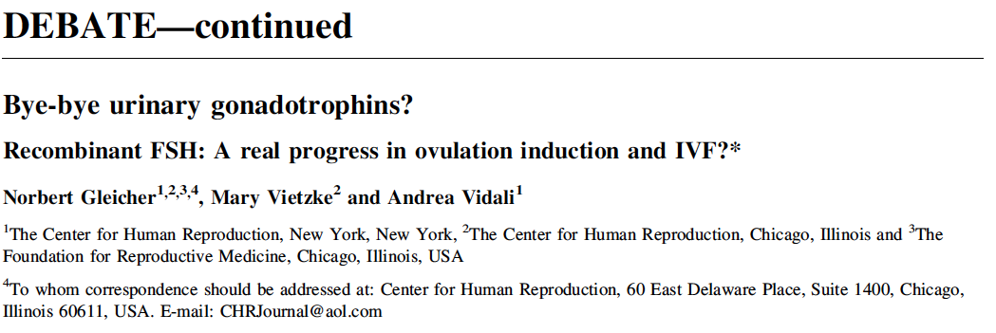
Human Reproduction Vol.18, No.3 pp. 476±482, 2003
There is, however, no convincing evidence that rFSH improves clinical outcome in either standard ovulation induction or with IVF. In fact, the opposite may be true and LH containing gonadotrophins may have an outcome advantage, especially in younger women with normal ovarian function, who undergo down-regulation with GnRH-agonists.
Since outcome affects cost to a large degree, the lower acquisition costs of urinary products represent a very signicant factor in choosing a preferred medication

Slide 29
Human Reproduction Vol.18, No.3 pp. 476±482, 2003
There is, however, no convincing evidence that rFSH improves clinical outcome in either standard ovulation induction or with IVF. In fact, the opposite may be true and LH containing gonadotrophins may have an outcome advantage, especially in younger women with normal ovarian function, who undergo down-regulation with GnRH-agonists.
Since outcome affects cost to a large degree, the lower acquisition costs of urinary products represent a very signicant factor in choosing a preferred medication

Slide 30
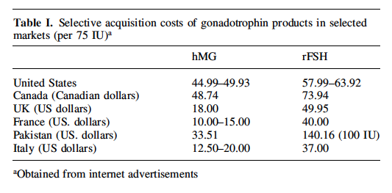

Slide 33
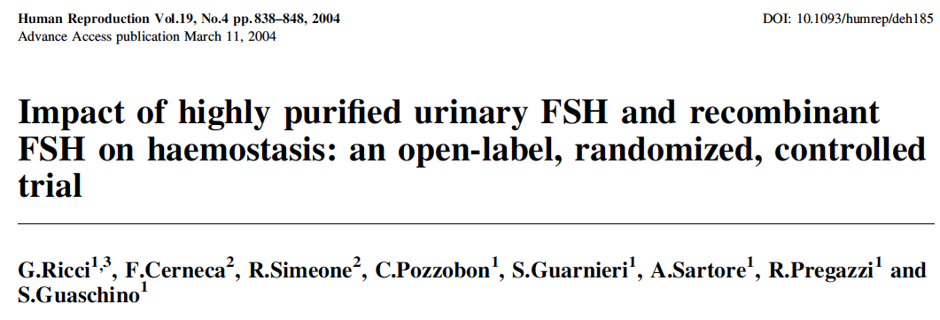
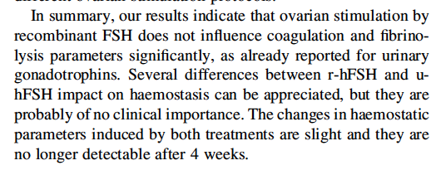

Slide 34
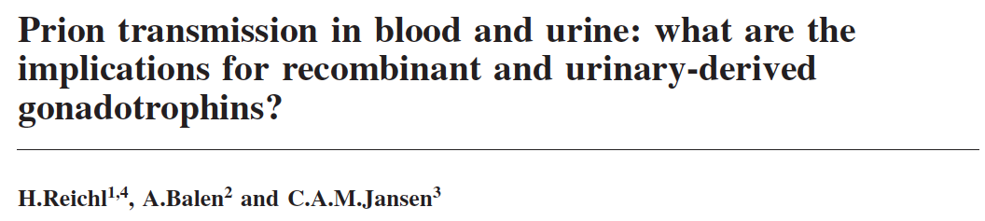

Slide 35
Notes:
[Intervention Review]
Recombinant versus urinary gonadotrophin for ovarian
stimulation in assisted reproductive technology cycles
Madelon van Wely1, Irene Kwan2, Anna L Burt3, Jane Thomas4, Andy Vail5, Fulco Van der Veen6, Hesham G Al-Inany7
1Centre for ReproductiveMedicine, Department of Obstetrics and Gynaecology, AcademicMedical Centre, University of Amsterdam,
Amsterdam, Netherlands. 2Evidence for Policy and Practice Information and Coordinating Centre (EPPI-Centre), Social Science
Research Unit (SSRU), Institute of Education, University of London, London, UK. 3National Collaborating Centre for Women‘s
and Children‘s Health, The Royal College of Obstetricians & Gynaecologists, London, UK. 4Cochrane MSDG FMHS, Auckland
University, Auckland, New Zealand. 5Health Methodology Research Group, University of Manchester, Salford, UK. 6Center for
Reproductive Medicine, Department of Obstetrics & Gynaecology, Academic Medical Center, University of Amsterdam, Amsterdam,
Netherlands. 7Obstetrics & Gynaecology, Faculty of Medicine, Cairo University, Cairo, Egypt
Contact address:Madelon vanWely,Centre for ReproductiveMedicine,Department ofObstetrics andGynaecology, AcademicMedical
Centre, University of Amsterdam, Center Meibergdreef 9, Amsterdam, 1105 AZ, Netherlands. m.vanwely@amc.uva.nl.
Editorial group: Cochrane Menstrual Disorders and Subfertility Group.
Publication status and date: Edited (no change to conclusions), comment added to review, published in Issue 12, 2012.
Review content assessed as up-to-date: 20 October 2010.
Citation: vanWelyM, Kwan I, Burt AL, Thomas J, Vail A, Van der Veen F, Al-Inany HG. Recombinant versus urinary gonadotrophin
for ovarian stimulation in assisted reproductive technology cycles. Cochrane Database of Systematic Reviews 2011, Issue 2. Art. No.:
CD005354. DOI: 10.1002/14651858.CD005354.pub2.
Copyright © 2012 The Cochrane Collaboration. Published by JohnWiley & Sons, Ltd.
A B S T R A C T
Background
Several systematic reviews compared recombinant gonadotrophin with urinary gonadotrophins (HMG, purified FSH, highly purified
FSH) for ovarian hyperstimulation in IVF and ICSI cycles and these reported conflicting results. Each of these reviews used different
inclusion and exclusion criteria for trials. Our aim in producing this review was to bring together all randomised studies in this field
under common inclusion criteria with consistent and valid statistical methods.
Objectives
To compare the effectiveness of recombinant gonadotrophin (rFSH) with the three main types of urinary gonadotrophins (i.e. HMG,
FSH-P and FSH-HP) for ovarian stimulation in women undergoing IVF or ICSI treatment cycles.
Search methods
An extended search was done according to Cochrane guidelines including the Menstrual Disorders & Subfertility Group’s Specialised
Register of controlled trials (up toMay 2010), The Cochrane Central Register of Controlled Trials (up toMay 2010),MEDLINE (1966
to May 2010), EMBASE (1980 to May 2010), CINAHL (1982 to May 2010), National Research Register, and Current Controlled
Trials (up to May 2010).
Selection criteria
All randomised controlled trials reporting data comparing clinical outcomes for women undergoing IVF/ICSI cycles and using recombinant
FSH in comparison with HMG or highly purified HMG, purified urinary FSH (FSH-P), and highly purified urinary FSH
(FSH-HP) for ovarian hyperstimulation in IVF or ICSI cycles were included.
Recombinant versus urinary gonadotrophin for ovarian stimulation in assisted reproductive technology cycles (Review)
Copyright © 2012 The Cochrane Collaboration. Published by JohnWiley & Sons, Ltd.

Slide 36
Several systematic reviews compared recombinant gonadotrophin with urinary gonadotrophins (HMG, purified FSH, highly purified FSH) for ovarian hyperstimulation in IVF and ICSI cycles and these reported conflicting results. Each of these reviews used different inclusion and exclusion criteria for trials. Our aim in producing this review was to bring together all randomised studies in this field under common inclusion criteria with consistent and valid statistical methods.
Notes:
Several systematic reviews compared recombinant gonadotrophin with urinary gonadotrophins (HMG, purified FSH, highly purified FSH) for ovarian hyperstimulation in IVF and ICSI cycles and these reported conflicting results. Each of these reviews used different inclusion and exclusion criteria for trials. Our aim in producing this review was to bring together all randomised studies in this field under common inclusion criteria with consistent and valid statistical methods.

Slide 37
We included 42 trials with a total of 9606 couples. Comparing rFSH to all other gonadotrophins combined, irrespective of the down-regulation protocol used, did not result in any evidence of a statistically significant difference in live birth rate (28 trials, 7339 couples, odds ratio (OR) 0.97, 95% CI 0.87 to 1.08). This suggests that for a group with a 25% live birth rate using urinary gonadotrophins the rate would be between 22.5% and 26.5% using rFSH. There was also no evidence of a difference in the OHSS rate (32 trials, 7740 couples, OR 1.18, 95% CI 0.86 to 1.61). This means that for a group with 2% risk of OHSS using urinary gonadotrophins, the risk would be between 1.7% and 3.2% using rFSH.
Notes:
We included 42 trials with a total of 9606 couples. Comparing rFSH to all other gonadotrophins combined, irrespective of the down-regulation protocol used, did not result in any evidence of a statistically significant difference in live birth rate (28 trials, 7339 couples, odds ratio (OR) 0.97, 95% CI 0.87 to 1.08). This suggests that for a group with a 25% live birth rate using urinary gonadotrophins the rate would be between 22.5% and 26.5% using rFSH. There was also no evidence of a difference in the OHSS rate (32 trials, 7740 couples, OR 1.18, 95% CI 0.86 to 1.61). This means that for a group with 2% risk of OHSS using urinary gonadotrophins, the risk would be between 1.7% and 3.2% using rFSH.

Slide 38
When different urinary gonadotrophins were considered separately, there were significantly fewer live births after rFSH than HMG (11 trials, N=3197, OR 0.84, 95% CI 0.72 to 0.99). This means that for a live birth rate of 25% using HMG, use of rFSH instead would be expected to result in a rate between 19% and 25%. There was no evidence of a difference in live births when rFSH was compared with FSH-P (5 trials, N=1430, OR 1.26, 95% CI 0.96 to 1.64) or when rFSH was compared with FSH-HP (13 trials, N=2712; OR 1.03, 95% CI 0.86 to 1.22).
Notes:
When different urinary gonadotrophins were considered separately, there were significantly fewer live births after rFSH than HMG (11 trials, N=3197, OR 0.84, 95% CI 0.72 to 0.99). This means that for a live birth rate of 25% using HMG, use of rFSH instead would be expected to result in a rate between 19% and 25%. There was no evidence of a difference in live births when rFSH was compared with FSH-P (5 trials, N=1430, OR 1.26, 95% CI 0.96 to 1.64) or when rFSH was compared with FSH-HP (13 trials, N=2712; OR 1.03, 95% CI 0.86 to 1.22).

Slide 39
Clinical choice of gonadotrophin should depend on availability, convenience and costs. Differences between urinary gonadotrophins were considered unlikely to be clinically significant.
Further research on these comparisons is unlikely to identify substantive differences in effectiveness or safety.
Notes:
Clinical choice of gonadotrophin should depend on availability, convenience and costs. Differences between urinary gonadotrophins were considered unlikely to be clinically significant. Further research on these comparisons is unlikely to identify substantive differences in effectiveness or safety.

Slide 43
This suggests that for a group with a 25% live birth rate using urinary gonadotrophins would be between 22.5% and 26.5% using rFSH. There was also no evidence of a difference in the OHSS rate (32 trials, 7740 couples, OR 1.18, 95% CI 0.86 to 1.61). This means that for a group with 2% risk of OHSS using urinary gonadotrophins, the risk
would be between 1.7% and 3.2% using rFSH.
When different urinary gonadotrophins were considered separately, there were significantly fewer live births after rFSH than HMG (11
trials, N=3197, OR 0.84, 95% CI 0.72 to 0.99). This means that for a live birth rate of 25% using HMG, use of rFSH instead would
be expected to result in a rate between 19% and 25%. There was no evidence of a difference in live births when rFSH was compared
with FSH-P (5 trials, N=1430, OR 1.26, 95% CI 0.96 to 1.64) or when rFSH was compared with FSH-HP (13 trials, N=2712; OR
1.03, 95% CI 0.86 to 1.22).
.

Slide 44
S U M M A R Y
Recombinant FSH versus urinary gonadotrophins (HMG, purified FSH, highly purified FSH) for ovarian hyperstimulation in IVF and ICSI cycles
Several systematic reviews compared recombinant FSH with urinary gonadotrophins (HMG, purified FSH, highly purified FSH) for ovarian hyperstimulation in IVF and ICSI cycles and these reported conflicting results.
We included 42 trials with in total 9606 couples. Comparing rFSH with urinary gonadotrophins overall did not result in any difference in live birth rate, OHSS or any of the other outcomes. Comparing rFSH with HMG/HP-HMG resulted in a significantly lower live birth rate in the rFSH group though differences were small. There was no proof of a difference in live birth when comparing rFSH with FSH-P or with FSH-HP. We may conclude that all these gonadotrophins are equally effective and safe, and that further trials are unwarranted.

Slide 45
S U M M A R Y
Recombinant FSH versus urinary gonadotrophins (HMG, purified FSH, highly purified FSH) for ovarian hyperstimulation in IVF and ICSI cycles
Several systematic reviews compared recombinant FSH with urinary gonadotrophins (HMG, purified FSH, highly purified FSH) for ovarian hyperstimulation in IVF and ICSI cycles and these reported conflicting results. We included 42 trials with in total 9606 couples. Comparing rFSH with urinary gonadotrophins overall did not result in any difference in live birth rate, OHSS or any of the
other outcomes. Comparing rFSH with HMG/HP-HMG resulted in a significantly lower live birth rate in the rFSH group though differences were small. There was no proof of a difference in live birth when comparing rFSH with FSH-P or with FSH-HP. We may conclude that all these gonadotrophins are equally effective and safe, and that further trials are unwarranted.

Slide 46
Prion transmission in blood and urine: what are implications for recombinant and urinary derived gonadotrophins?
Human Reproduction Vol.17, No.10 pp. 2501–2508, 2002
Production of human menopausal and recombinant gonadotrophin preparations for use in ovarian stimulation protocols in fertility needs to ensure that safety of such drugs remains as high as ever.
Recombinant preparations utilize fetal calf serum or other animal sera or proteins as part of a culture medium during production.
Human urinary-derived menotrophin preparations are exposed to theoretical risk of infection from menopausal donors of urine

Slide 47
Bye-bye urinary gonadotrophins? Recombinant FSH:
A real progress in ovulation induction and IVF?*
Norbert Gleicher, Mary Vietzke and Andrea Vidali
Human Reproduction Vol.18, No.3 pp. 476±482, 2003
Recombinant gonadotrophin products do, indeed, represent progress for routine ovulation induction and IVF cycles.
Safety considerations favour recombinant products, while overall outcome and cost considerations favour urinary gonadotrophins.
Outcome, appears to differ, based on age and ovarian function, with younger patients benefiting from the FSH/LH combination offered by urinary products, while older women and young women with ovarian resistance, apparently benefting from pure FSH stimulation.

Slide 48
Bye-bye urinary gonadotrophins? Recombinant FSH:
A real progress in ovulation induction and IVF?*
Norbert Gleicher, Mary Vietzke and Andrea Vidali
Human Reproduction Vol.18, No.3 pp. 476±482, 2003
Young women with poor ovarian reserve may be best stimulated with a pure FSH/ antagonist protocol.
Conclusion: under current pricing structures in the US recombinant gonadotrophins do not represent a major progress for the treatments of ovulation induction and IVF.
They, however, allow for an improved selectivity of stimulation protocols.
The creation of recombinant FSH/LH products and cost adjustments for recombinant products, may affect these conclusions in favour of recombinant products.

Slide 49
Impact of highly purified urinary FSH and recombinant FSH on haemostasis: an open‐label, randomized, controlled trial
Human Reproduction Volume 19, Issue 4 Pp. 838-848, 2004
G. Ricci R. Simeone C. Pozzobon S. Guarnieri A. Sartore R. Pregazzi S. Guaschino
CONCLUSIONS:
Ovarian stimulation with recombinant FSH does not influence coagulation and fibrinolysis significantly, as already reported for urinary gonadotrophins.
The moderate changes induced by both treatments are no longer detectable after 4 weeks.

