Slide 1
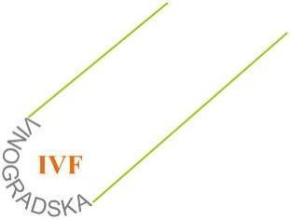

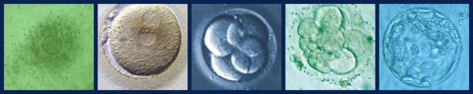
USPOREDBA RAZLIČITIH LIJEKOVA ZA STIMULACIJU OVULACIJE I ISHOD MPO
Krunoslav Kuna, Dejan Ljiljak, Jozo Tomić, Ivan Bolanča
Klinika za ginekologiju i porodništvo
KBC Sestre milosrdnice
Šibenik, 17. svibnja 2014.
3. hrvatski kongres o reprodukcijskom zdravlju, kontracepciji i IVF-u

Slide 2
O ČEMU ĆE BITI RIJEČ?
Uvod
Vrste gonadotropina
Usporedba učinkovitosti i nuspojava
Naši rezultati

Slide 3
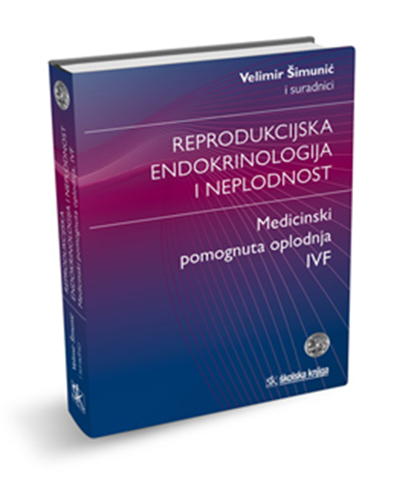
... A O ČEMU NEĆE BITI RIJEČI?
Mehanizam djelovanja gonadotropina
Farmakokinetika
Farmakodinamika
Protokoli stimulacije
.......

Slide 4
CILJEVI STIMULACIJE
INDUKCIJA OVULACIJE
SUPEROVULACIJA- COH
Monofolikularna stimulacija kod anovulatornih žena
Produkcija više zrelih oocita

Slide 5
Kako do cilja?
Gonadotropini
3 PROIZVODA
FSH
LH
HCG
2 NAČINA DOBIVANJA
Urinarni
Rekombinantni

Slide 6
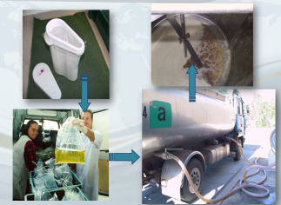
Urinarni gonadotropini
HMG
urin postmenopauzalnih žena
Sadržaj
jednak omjer FSH i LH (75 IU/amp)
Urinarni proteini – mogući antigeni učinak
Primjena – intramuskularno
HP-HMG
Sadržaj
jednak omjer FSH i LH (75 IU/amp)
Urinarni proteini – ispod 5%
Primjena - potkožno

Slide 7
Urinarni gonadotropini
Urinarni HCG
Proizveden od urina trudnih žena i placentarnog tkiva
Simulira porast LH – završno sazrijevanje oocite
Doze 5000-10000 IU

Slide 8
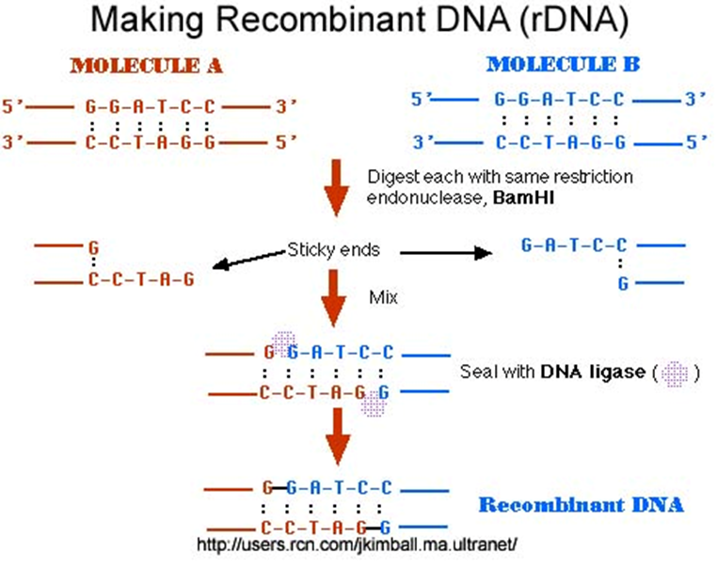
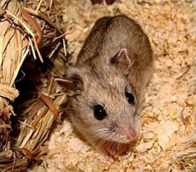
Rekombinantni gonadotropini
rFSH
Tehnologija rekombinantne DNA
Sadržaj
FSH izoforme
Prednosti
Izostanak proteina
Teoretski manje varijacije između serija
Opskrba neovisna o sirovini
Rec HCG
Rec LH

Slide 9
Prednosti rekombinantne tehnologije
Kontrola ulazne sirovine
Čistoća i specifičnost (Bassett et al, 2005)
Učinkovitost
Sigurnost
Individualizirani protokol prema potrebama žene
Optimizirana kvaliteta oocite (Hugues et al.,2002 Balasch et al, 2004)
……

Slide 10
Urinarni gonadotropini
Preparat | Zaštićeno ime | Put primjene | Urinarni proteini | FSH | LH | Tvrtka
1. HMG | Pergonal, Humegon, Menogon, | IM | 95% | 75 | 75 | MERCK Serono Organon
2. H.P.HMG | Menopur Merional | SC | <5% | 75 75/150 | 75 75/150 | Ferring IBSA
3. Purificirani FSH | Metrodine | IM | <5% | 75/150 | <0.1 | MERCK Serono
4. H.P.FSH | Fostimon Bravelle | SC, IM | <5% | 75 | <0.001 | IBSA Ferring
5. HCG | Brevactid/Choragon Pregnyl Profasi | IM | 95% |  |  | Ferring MSD (Organon) MERCK Serono
6. H.P.HCG | Choriomon | SC,IM | <5% |  |  | IBSA

Slide 11
Rekombinantni gonadotropini
Preparat | Zaštićeno ime | Put primjene | Urinarni proteini | FSH | LH | Tvrtka
1. FSH | Gonal-f (follitropinα) Gonal-f FbM Pen Puregon (follitropinβ) Puregon pen | SC, IM SC, IM SC,IM SC, Im | - - - - | 75,150 300,450,900 50,100 300,600 | - - - - | MERCK Serono MERCK Serono MSD (Organon) MSD (Organon)
2. HCG | Ovitrelle / Ovidrel Choriogonadotropinα | SC | - | - | - | MERCK Serono
3. LH | Luveris lutotropinα | SC | - | - | 75 | MERCK Serono
4. FSH+LH | Pergoveris follitropin α+ lutotropinα | SC | - | 150 | 75 | MERCK Serono

Slide 12
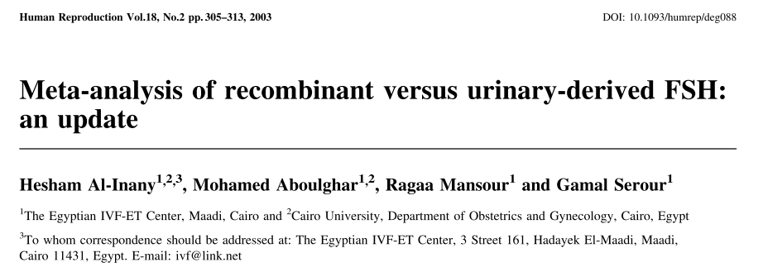
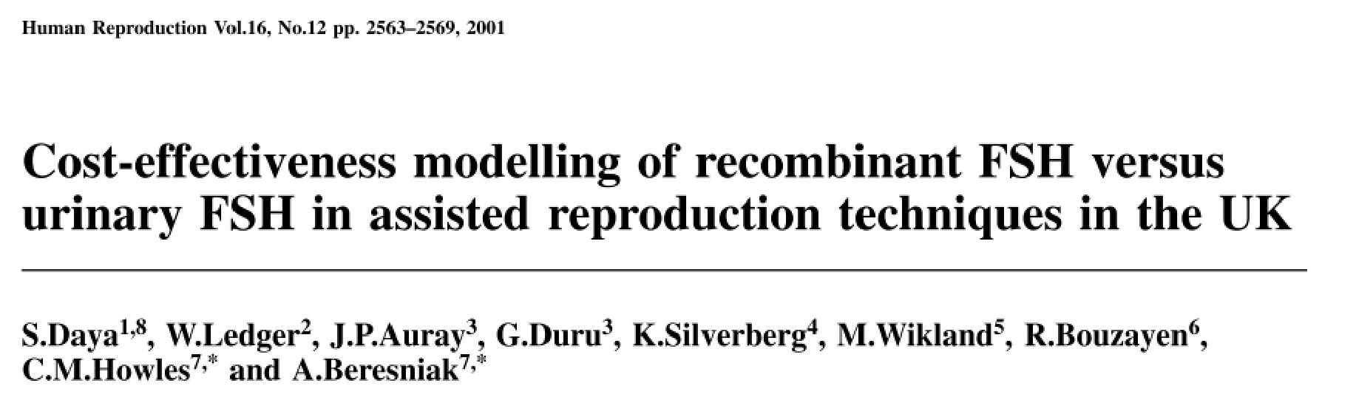
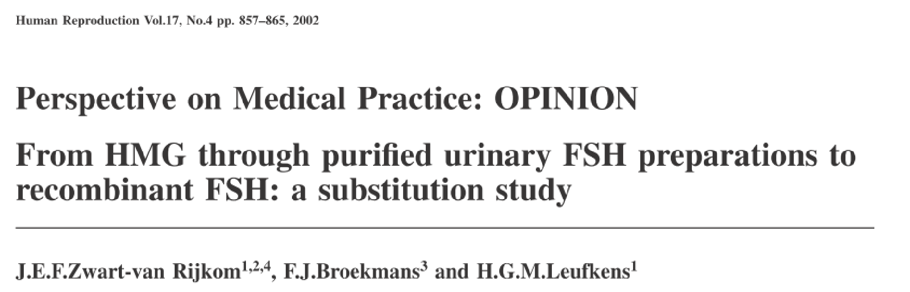
Notes:
Ubaciti još radova u istom stilu

Slide 13
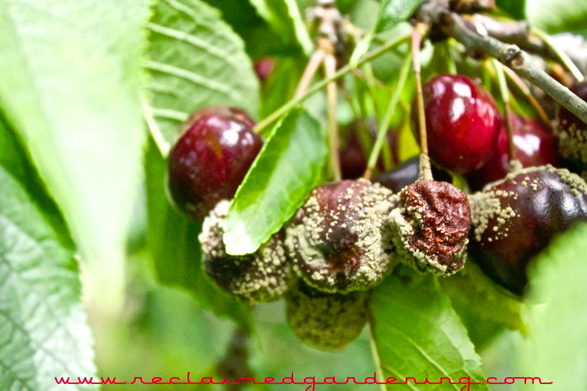

Slide 14
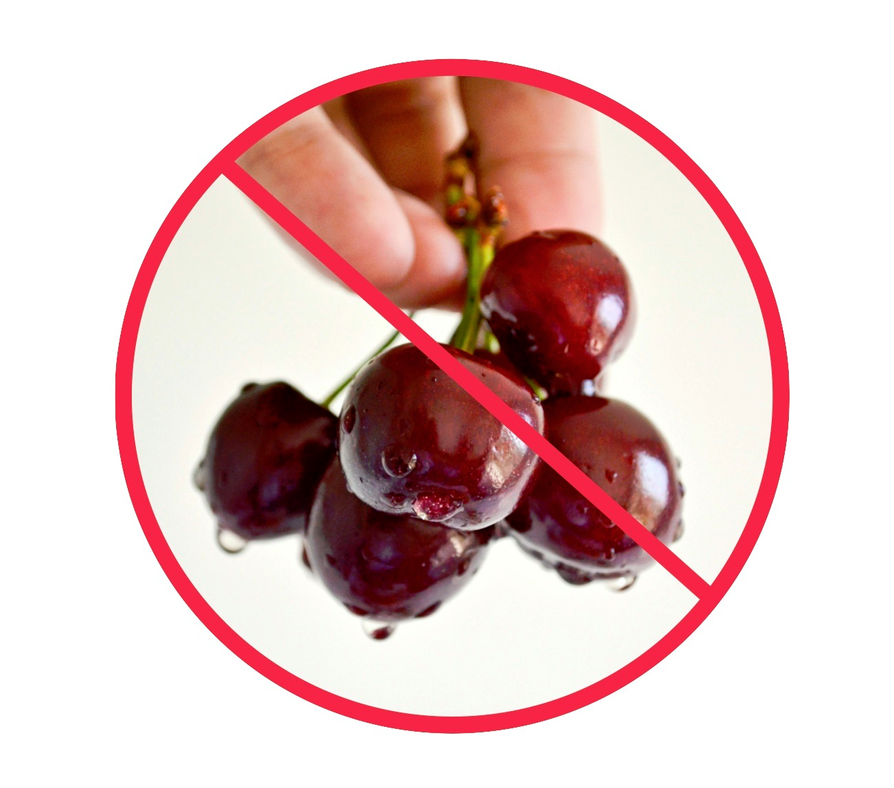


Slide 15

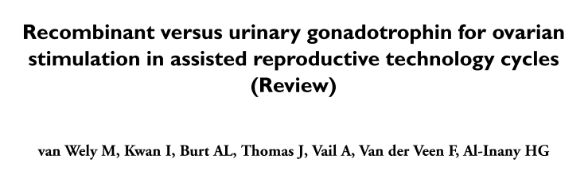


Slide 16
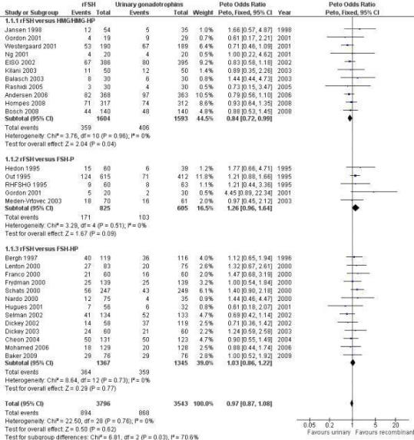

Recombinant versus urinary gonadotrophin for ovarian stimulation in assisted reproductive technology cycles
van Wely, Madelon; Kwan, Irene; Burt, Anna L; Thomas, Jane; Vail, Andy; Van der Veen, Fulco; AlInany, Hesham G
Cochrane Database of Systematic Reviews. Issue 12, 2012.
Figure 6 . Forest plot of comparison: 1 rFSH versus urinary gonadotrophins: primary analyses, outcome: 1.1 Live birth (or ongoing pregnancy) by urinary gonadotrophin.
The Cochrane Library, Copyright 2012, The Cochrane Collaboration.
Notes:
There was no evidence of a statistically signiﬁcant difference in the primary outcome live births or pregnancies ongoing beyond 20 weeks (28 trials, N=7339; Analysis 1.1; OR 0.97, 95% CI 0.87 to 1.08) for rFSH versus urinary gonadotrophins. This means that of 25% live births using urinary gonadotrophins, use of rFSH instead would be expected to result in a live birth rate between 22.5% and 26.5%. There was no indication of statistical heterogeneity. Visual inspection of the forest plot showed that the OR and 95%CI of the individual trials overlapped and the I2 was 0%. 1.1 Live birth (or pregnancy ongoing beyond 20 wk’s) grouped by the different urinary gonadotrophins.
There were signiﬁcantly fewer live births after rFSH as compared to HMG (OR 0.84, 95% CI 0.72 to 0.99; 11 trials, N=3197;Analysis 1.1 ). This means that for a live birth rate of 25%, use
of rFSH instead would be expected to result in a live birth rate between 19% and 25%. There was no indication of statistical heterogeneity. Visual inspection of the forest plot showed that the OR and 95% CI of the individual trials largely overlapped and the I2 was 0%. Pooling using a random effects model resulted in the same OR. There was no evidence of a statistically signiﬁcant difference in live birth between rFSH and FSH-P (5 trials, N=1430; Analysis 1.1. OR 1.26, 95% CI 0.96 to 1.64; I2 of 0%;) and between rFSH and FSH-HP (13 trials, N=2712; Analysis 1.1. OR 1.03, 95% CI 0.86 to 1.22; I2 of 0%).

Slide 17
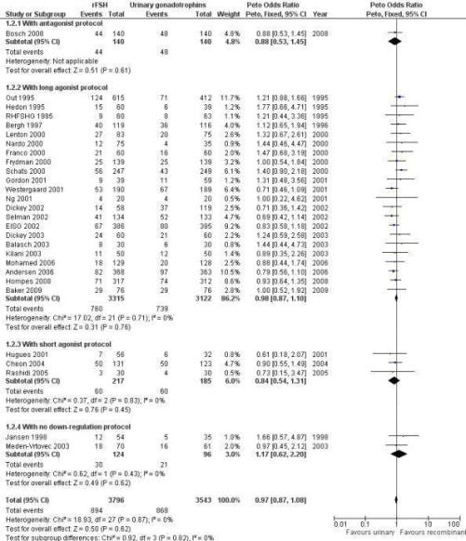
Recombinant versus urinary gonadotrophin for ovarian stimulation in assisted reproductive technology cycles
van Wely, Madelon; Kwan, Irene; Burt, Anna L; Thomas, Jane; Vail, Andy; Van der Veen, Fulco; AlInany, Hesham G
Cochrane Database of Systematic Reviews. Issue 12, 2012.
Figure 7 . Forest plot of comparison: 1 rFSH versus urinary gonadotrophins: primary analyses, outcome: 1.2 Live birth (or ongoing pregnancy) by down regulation protocol.
The Cochrane Library, Copyright 2012, The Cochrane Collaboration.
Notes:
There was no evidence of a statistically signiﬁcant difference in live birth between rFSH and urinary gonadotrophins for any of
the down regulation protocols (antagonist protocol, 1 trial, N= 280; Analysis 1.2; OR 0.88, 95% CI 0.53 to 1.45), (long GnRHa
protocol, 22 trials, N=6437; OR 0.98, 95% CI 0.87 to 1.10; Analysis 1.2), (short GnRHa protocol,3 trials, N=402; Analysis
1.2; OR 0.84, 95% CI 0.54 to 1.31), (no down regulation, 2 trials, N=220; Analysis 1.2; OR 1.17, 95% CI 0.62 to 2.20 ). There was no indication of statistical heterogeneity ( I2 of 0%).

Slide 18
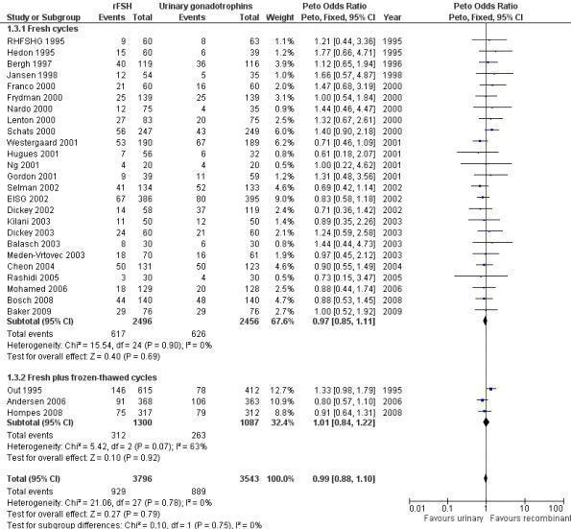
Recombinant versus urinary gonadotrophin for ovarian stimulation in assisted reproductive technology cycles
van Wely, Madelon; Kwan, Irene; Burt, Anna L; Thomas, Jane; Vail, Andy; Van der Veen, Fulco; AlInany, Hesham G
Cochrane Database of Systematic Reviews. Issue 12, 2012.
Figure 8 . Forest plot of comparison: 1 rFSH versus urinary gonadotrophins: primary analyses, outcome: 1.3 Live birth (or ongoing pregnancy) by fresh/frozen policy.
The Cochrane Library, Copyright 2012, The Cochrane Collaboration.
Notes:
Of the 28 trials with data on live births the outcome of frozen- thawed cycles was known for only three trials (for the correspond-ing forest plot see Figure 8). There was no evidence of a statistically signiﬁcant difference between rFSH and urinary gonadotrophins for live births after fresh cycles (25 trials, N=4952; Analysis 1.3; OR 0.97, 95% CI 0.85 to 1.11) and for cumulative live birth rate after fresh and frozen-thawed cycles (3 trials, N=2387; Analysis 1.3; OR 1.01, 95% CI 0.84 to 1.22). There was no indication of statistical heterogeneity ( I2 of 0%).

Slide 19
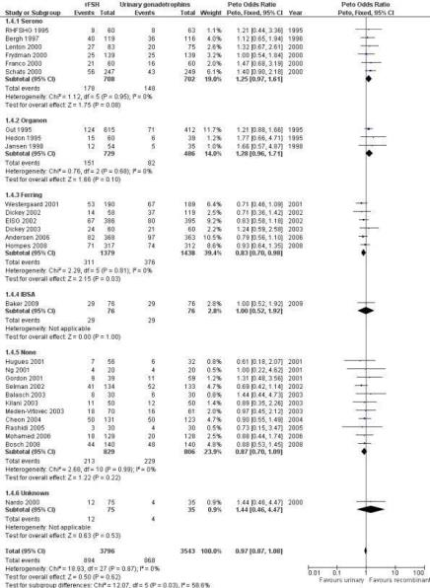
Recombinant versus urinary gonadotrophin for ovarian stimulation in assisted reproductive technology cycles
van Wely, Madelon; Kwan, Irene; Burt, Anna L; Thomas, Jane; Vail, Andy; Van der Veen, Fulco; AlInany, Hesham G
Cochrane Database of Systematic Reviews. Issue 12, 2012.
Figure 9 . Forest plot of comparison: 1 rFSH versus urinary gonadotrophins: primary analyses, outcome: 1.4 Live birth (or ongoing pregnancy) by sponsor.
The Cochrane Library, Copyright 2012, The Cochrane Collaboration.
Notes:
Of the 28 trials with data on live births six trials were sponsored by Serono, three trials were sponsored by Organon - now MSD, six trials were sponsored by Ferring, one trials was sponsored by IBSA, 11 trials were not sponsored by a pharmaceutical company and for one trial sponsoring was unknown (for the corresponding forest plot see Figure 9).
There was no evidence of a statistically signiﬁcant difference in live births between rFSH and urinary gonadotrophins for the trials sponsored by Serono (6 trials, N=1410; Analysis 1.4; OR 1.25, 95% CI 0.97 to 1.61), the trials sponsored by Organon (3 tri- als, N=1215; Analysis 1.4; OR 1.28, 95% CI 0.96 to 1.71), the trial sponsored by IBSA (1 trials N=152; Analysis 1.4; OR 1.00, 95% CI 0.52 to 1.92), and the non-sponsored trials (11 trials, N=1635; Analysis 1.4; OR 0.87, 95% CI 0.70 to 1.09). However, there were signiﬁcantly fewer live births after rFSH as compared to urinary gonadotrophins for the trials sponsored by Ferring (6 trials, N=2817; Analysis 1.4; OR 0.83, 95% CI 0.69 to 0.98). To evaluate whether this is a pharmaceutical effect or really a result from the interventions done an additional unplanned sub analysis was performed (see last results section Extra unplanned analysis). There was no indication of statistical heterogeneity for any of these grouped comparisons (I2 was 0%).

Slide 20
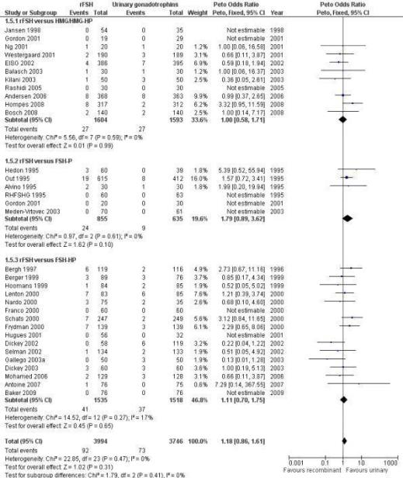
Recombinant versus urinary gonadotrophin for ovarian stimulation in assisted reproductive technology cycles
van Wely, Madelon; Kwan, Irene; Burt, Anna L; Thomas, Jane; Vail, Andy; Van der Veen, Fulco; AlInany, Hesham G
Cochrane Database of Systematic Reviews. Issue 12, 2012.
Figure 10 . Forest plot of comparison: 1 rFSH versus urinary gonadotrophins: primary analyses, outcome: 1.5 OHSS by urinary gonadotrophin.
The Cochrane Library, Copyright 2012, The Cochrane Collaboration.
Notes:
There was no evidence of a statistically signiﬁcant difference in the primary safety outcome OHSS for rFSH versus urinary gonadotrophins (32 trials, N=7740; Analysis 1.5; OR 1.18, 95% CI 0.86 to 1.61; I2 of 0%). This means that for a typical rate of 2% OHSS using urinary gonadotrophins, use of rFSH instead would be expected to result in an OHSS rate between 1.7% and 3.2% OHSS. There was no indication for statistical heterogeneity. Visual inspection of the forest plot showed that the OR and 95%CI of the individual trials overlapped and the I2 was 0%.

Slide 21
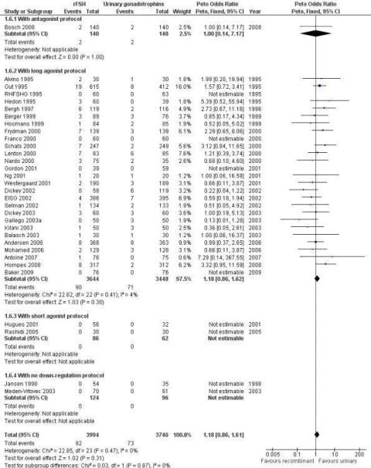
Recombinant versus urinary gonadotrophin for ovarian stimulation in assisted reproductive technology cycles
van Wely, Madelon; Kwan, Irene; Burt, Anna L; Thomas, Jane; Vail, Andy; Van der Veen, Fulco; AlInany, Hesham G
Cochrane Database of Systematic Reviews. Issue 12, 2012.
Figure 11 . Forest plot of comparison: 1 rFSH versus urinary gonadotrophins: primary analyses, outcome: 1.6 OHSS by down regulation protocol.
The Cochrane Library, Copyright 2012, The Cochrane Collaboration.
Notes:
There was no evidence of a statistically signiﬁcant difference in OHSS between rFSH and urinary gonadotrophins for any of the down regulation protocols (antagonist protocol, N=280; Analysis 1.6; OR 1.00, 95% CI 0.14 to 7.17), (long GnRHa protocol, N=7092; Analysis 1.6; OR 1.18, 95% CI 0.86 to 1.62), (short GnRHa protocol, N=148; Analysis 1.6; OR not estimable due to lack of OHSS cases), (no down regulation, N=220; OR not estimable due to lack of OHSS cases). There was no indication for statistical heterogeneity for any of these grouped comparisons

Slide 22
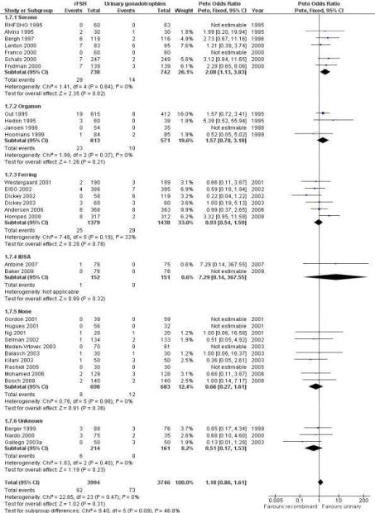
Recombinant versus urinary gonadotrophin for ovarian stimulation in assisted reproductive technology cycles
van Wely, Madelon; Kwan, Irene; Burt, Anna L; Thomas, Jane; Vail, Andy; Van der Veen, Fulco; AlInany, Hesham G
Cochrane Database of Systematic Reviews. Issue 12, 2012.
Figure 12 . Forest plot of comparison: 1 rFSH versus urinary gonadotrophins: primary analyses, outcome: 1.8 OHSS by sponsor.
The Cochrane Library, Copyright 2012, The Cochrane Collaboration.
Notes:
There was more OHSS in the rFSH group as compared to urinary gonadotrophins in studies sponsored by Serono (7 trials, N=
1480; Analysis 1.7; OR 2.08, 95% CI 1.13 to 3.83). There was no evidence of a statistically signiﬁcant difference in OHSS between rFSH and urinary gonadotrophins for the trials sponsored by Organon (4 trials, N=1387; Analysis 1.7; OR 1.57, 95% CI 0.78 to 3.18), the trials sponsored by Ferring (6 trials, N=2817; Analysis 1.7; OR 0.93, 95% CI 0.54 to 1.59), the trials sponsored by IBSA (2 trials N=303; Analysis 1.7; OR 7.29, 95% CI 0.14 to 368), the sponsoring unknown trials (3 trials N=375; Analysis 1.7; OR 0.51, 95% CI 0.17 to 1.53) and the non-sponsored trials (10 trials, N=1381; Analysis 1.7; OR 0.66, 95% CI 0.27 to 1.61). There was no indication for statistical heterogeneity for any of these grouped comparisons (I2 was 0%).

Slide 23
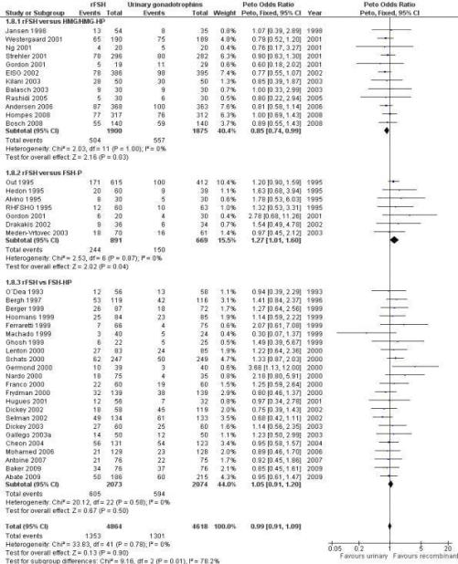
Recombinant versus urinary gonadotrophin for ovarian stimulation in assisted reproductive technology cycles
van Wely, Madelon; Kwan, Irene; Burt, Anna L; Thomas, Jane; Vail, Andy; Van der Veen, Fulco; AlInany, Hesham G
Cochrane Database of Systematic Reviews. Issue 12, 2012.
Figure 13 . Forest plot of comparison: 1 rFSH versus urinary gonadotrophins: primary analyses, outcome: 1.9 Clinical pregnancy by urinary gonadotrophin.
The Cochrane Library, Copyright 2012, The Cochrane Collaboration.
Notes:
There was no evidence of a statistically signiﬁcant difference in the clinical pregnancy rate (41 trials, N=9482; Analysis 1.8; OR 0.99, 95% CI 0.91 to 1.09) for rFSH versus urinary gonadotrophins. This means that for a typical clinical pregnancy rate of 28% using urinary gonadotrophins, use of rFSH instead would be expected to result in a clinical pregnancy rate between 26% and 30%. There was no indication of statistical heterogeneity. Visual inspection of the forest plot showed that the OR and 95%CI of the individual trials overlapped and the I2 was 0%.
There were signiﬁcantly fewer clinical pregnancies after rFSH as compared to HMG/HP-HMG (OR 0.85, 95% CI 0.74 to 0.99; I2 of 0%; 12 trials, N=3775; Analysis 1.8). This means that for a typical clinical pregnancy rate of 28% using HMG/HP-HMG, use of rFSH instead would be expected to result in a clinical pregnancy rate between 23% and 28%. There were signiﬁcantly more clinical pregnancies after rFSH as compared to FSH-P (OR 1.27, 95% CI 1.01 to 1.60; I2 of 0%; 7 trials, N=1560; Analysis 1.8 ). This means that for a typical clinical pregnancy rate of 28% using FSH-P, use of rFSH instead would be expected to result in a clinical pregnancy rate between 28% and 40%.There was no evidence of a statistically signiﬁcant difference in clinical pregnancy rate between rFSH and FSH-P (23 trials, N=4147; Analysis 1.8; OR 1.05, 95% CI 0.91 to 1.20; I2 of 0%).

Slide 24
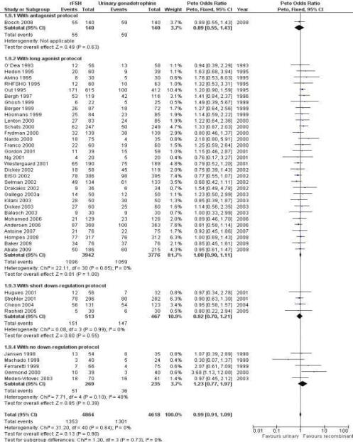
Recombinant versus urinary gonadotrophin for ovarian stimulation in assisted reproductive technology cycles
van Wely, Madelon; Kwan, Irene; Burt, Anna L; Thomas, Jane; Vail, Andy; Van der Veen, Fulco; AlInany, Hesham G
Cochrane Database of Systematic Reviews. Issue 12, 2012.
Figure 14 . Forest plot of comparison: 1 rFSH versus urinary gonadotrophins: primary analyses, outcome: 1.10 Clinical pregnancy by down regulation protocol.
The Cochrane Library, Copyright 2012, The Cochrane Collaboration.
Notes:
There was no evidence of a statistically signiﬁcant difference in clinical pregnancy rate between rFSH and urinary gonadotrophins for any of the down regulation protocols (antagonist protocol, N= 280; Analysis 1.9; OR 0.89, 95% CI 0.55 to 1.43), (long GnRHa protocol, N=7718; Analysis 1.9; OR 1.00, 95% CI 0.90 to 1.11), (short GnRHa protocol, N=980; Analysis 1.9; OR 0.92, 95% CI 0.70 to 1.21), (no down regulation, N=504; Analysis 1.9; OR 1.23, 95% CI 0.77 to 1.97). There was no indication of any statistical heterogeneity of these grouped comparisons (I2 was 0%)

Slide 25
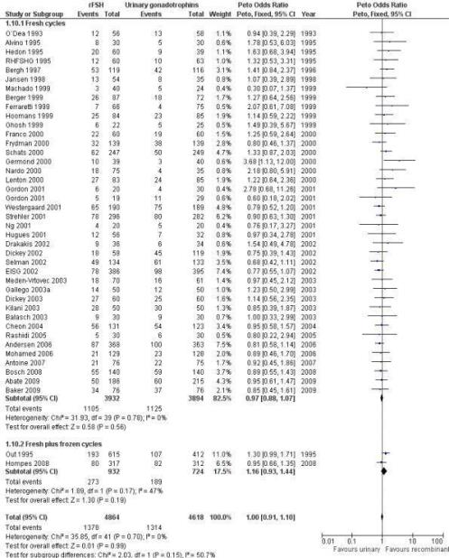
Recombinant versus urinary gonadotrophin for ovarian stimulation in assisted reproductive technology cycles
van Wely, Madelon; Kwan, Irene; Burt, Anna L; Thomas, Jane; Vail, Andy; Van der Veen, Fulco; AlInany, Hesham G
Cochrane Database of Systematic Reviews. Issue 12, 2012.
Figure 15 . Forest plot of comparison: 1 rFSH versus urinary gonadotrophins: primary analyses, outcome: 1.11 Clinical pregnancy by fresh/frozen policy.
The Cochrane Library, Copyright 2012, The Cochrane Collaboration.
Notes:
Of the 41 trials with data on clinical pregnancies the outcome of frozen-thawed cycles was known for only two trials (for the
corresponding forest plot see Figure 15). There was no evidence of a statistically signiﬁcant difference between rFSH and urinary
gonadotrophins for clinical pregnancy rate after fresh cycles (39 trials, N=8744; Analysis 1.10; OR 0.97, 95% CI 0.88 to 1.07)
and for cumulative clinical pregnancy rate after fresh and frozen- thawed cycles (2 trials, N=1656; Analysis 1.10; OR 1.16, 95% CI 0.93 to 1.44). There was no indication of statistical heterogeneity ( I2 of 0%).

Slide 26
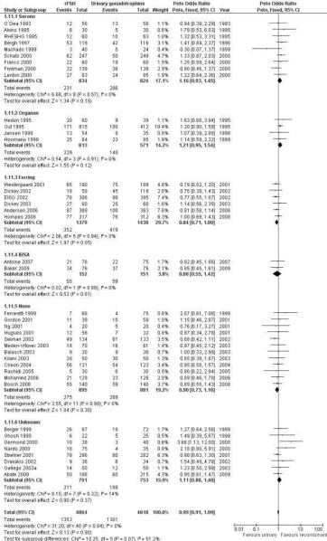
Recombinant versus urinary gonadotrophin for ovarian stimulation in assisted reproductive technology cycles
van Wely, Madelon; Kwan, Irene; Burt, Anna L; Thomas, Jane; Vail, Andy; Van der Veen, Fulco; AlInany, Hesham G
Cochrane Database of Systematic Reviews. Issue 12, 2012.
Figure 16 . Forest plot of comparison: 1 rFSH versus urinary gonadotrophins: primary analyses, outcome: 1.12 Clinical pregnancy by sponsor.
The Cochrane Library, Copyright 2012, The Cochrane Collaboration.
Notes:
There was no evidence of a statistically signiﬁcant difference in
clinical pregnancy rate between rFSH and urinary gonadotrophins
for the trials sponsored by Sereno (9 trials, N=1658; Analysis 1.11;
OR 1.16, 95% CI 0.93 to 1.45), the trials sponsored by Organon
(4 trials, N=1384; OR 1.21, 95% CI 0.95 to 1.54), the trials
sponsored by IBSA (2 trials, N=303; Analysis 1.11; OR 0.88,
95% CI 0.55 to 1.42), and the non-sponsored trials (12 trials, N=
1776; Analysis 1.11; OR 0.90, 95% CI 0.73 to 1.10). However,
there were borderline signiﬁcantly fewer live births after rFSH as
compared to urinary gonadotrophins for the trials sponsored by
Ferring (6 trials, N=2817; Analysis 1.11; OR 0.84, 95% CI 0.71 to
1.00). To evaluate whether this is a pharmaceutical effect or really
a result from the interventions done an additional unplanned sub
analysis was performed (see last results section Extra unplanned
analysis) There was no indication of statistical heterogeneity for
any of these grouped comparisons (I2 was 0%).

Slide 27
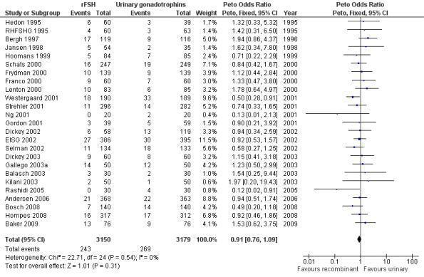
Recombinant versus urinary gonadotrophin for ovarian stimulation in assisted reproductive technology cycles
van Wely, Madelon; Kwan, Irene; Burt, Anna L; Thomas, Jane; Vail, Andy; Van der Veen, Fulco; AlInany, Hesham G
Cochrane Database of Systematic Reviews. Issue 12, 2012.
Figure 17 . Forest plot of comparison: 1 rFSH versus urinary gonadotrophins: primary analyses, outcome: 1.15 Multiple pregnancy (per woman).
The Cochrane Library, Copyright 2012, The Cochrane Collaboration.
Notes:
There was no evidence of a statistically signiﬁcant difference in
multiple pregnancy rate per woman (25 trials, N=6329; Analysis
1.12; OR 0.91, 95% CI 0.76 to1.09) for rFSH versus urinary
gonadotrophins (for the corresponding forest plot see Figure 17),
nor for multiple pregnancy rate as expressed per clinical pregnancy
(25 trials, N=6329; Analysis 1.13; OR 0.96, 95% CI 0.78 to 1.18)
(for the corresponding forest plot see Figure 18). For both multiple
pregnancy outcomes the I2 was 0%.

Slide 28
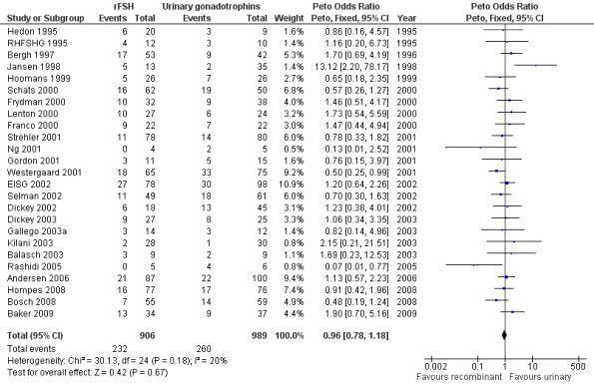
Recombinant versus urinary gonadotrophin for ovarian stimulation in assisted reproductive technology cycles
van Wely, Madelon; Kwan, Irene; Burt, Anna L; Thomas, Jane; Vail, Andy; Van der Veen, Fulco; AlInany, Hesham G
Cochrane Database of Systematic Reviews. Issue 12, 2012.
Figure 18 . Forest plot of comparison: 1 rFSH versus urinary gonadotrophins: primary analyses, outcome: 1.16 Multiple pregnancy (per pregnancy).
The Cochrane Library, Copyright 2012, The Cochrane Collaboration.
Notes:
There was no evidence of a statistically signiﬁcant difference in
multiple pregnancy rate per woman (25 trials, N=6329; Analysis
1.12; OR 0.91, 95% CI 0.76 to1.09) for rFSH versus urinary
gonadotrophins (for the corresponding forest plot see Figure 17),
nor for multiple pregnancy rate as expressed per clinical pregnancy
(25 trials, N=6329; Analysis 1.13; OR 0.96, 95% CI 0.78 to 1.18)
(for the corresponding forest plot see Figure 18). For both multiple
pregnancy outcomes the I2 was 0%.

Slide 29
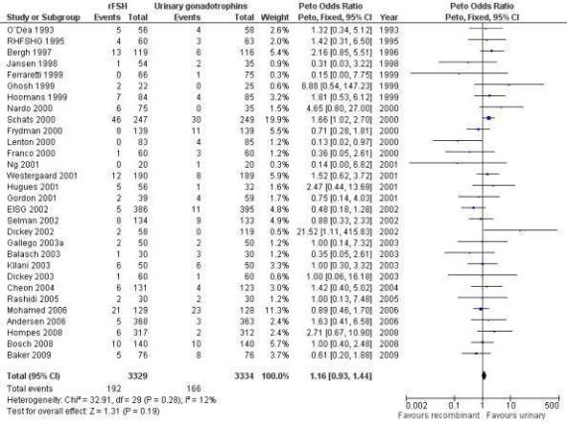
Recombinant versus urinary gonadotrophin for ovarian stimulation in assisted reproductive technology cycles
van Wely, Madelon; Kwan, Irene; Burt, Anna L; Thomas, Jane; Vail, Andy; Van der Veen, Fulco; AlInany, Hesham G
Cochrane Database of Systematic Reviews. Issue 12, 2012.
Figure 19 . Forest plot of comparison: 1 rFSH versus urinary gonadotrophins: primary analyses, outcome: 1.17 Miscarriage (per woman).
The Cochrane Library, Copyright 2012, The Cochrane Collaboration.
Notes:
There was no evidence of a statistically signiﬁcant difference in
miscarriage rate (30 trials, N=6663; Analysis 1.14; OR 1.16, 95%
CI 0.95 to 1.47) with an I2 of 0 (for the corresponding forest plot
see Figure 19 ).

Slide 30
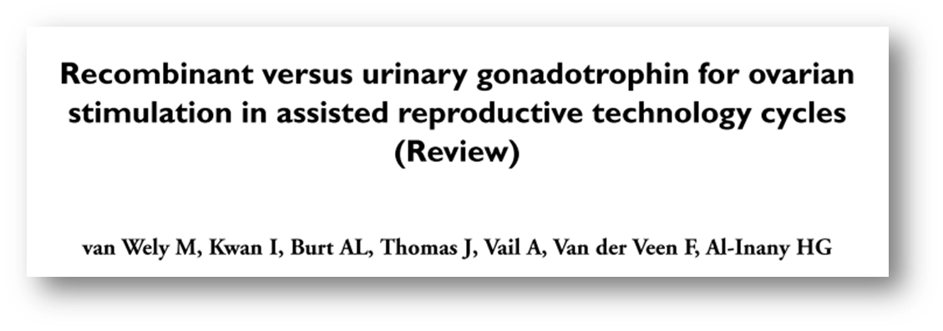
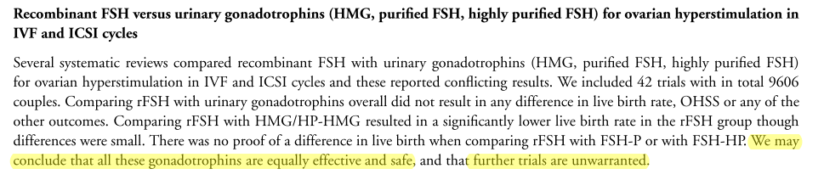

The Cochrane Library, Copyright 2012, The Cochrane Collaboration.

Slide 31

Notes:
I taman kad mislimo da smo pronašli rješenje naših dvojbi i da više ne moramo brinuti o tome koji ćemo lijek dalje koristiti

Slide 32
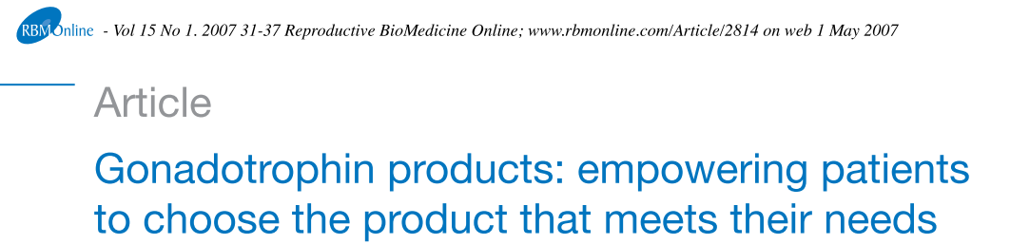
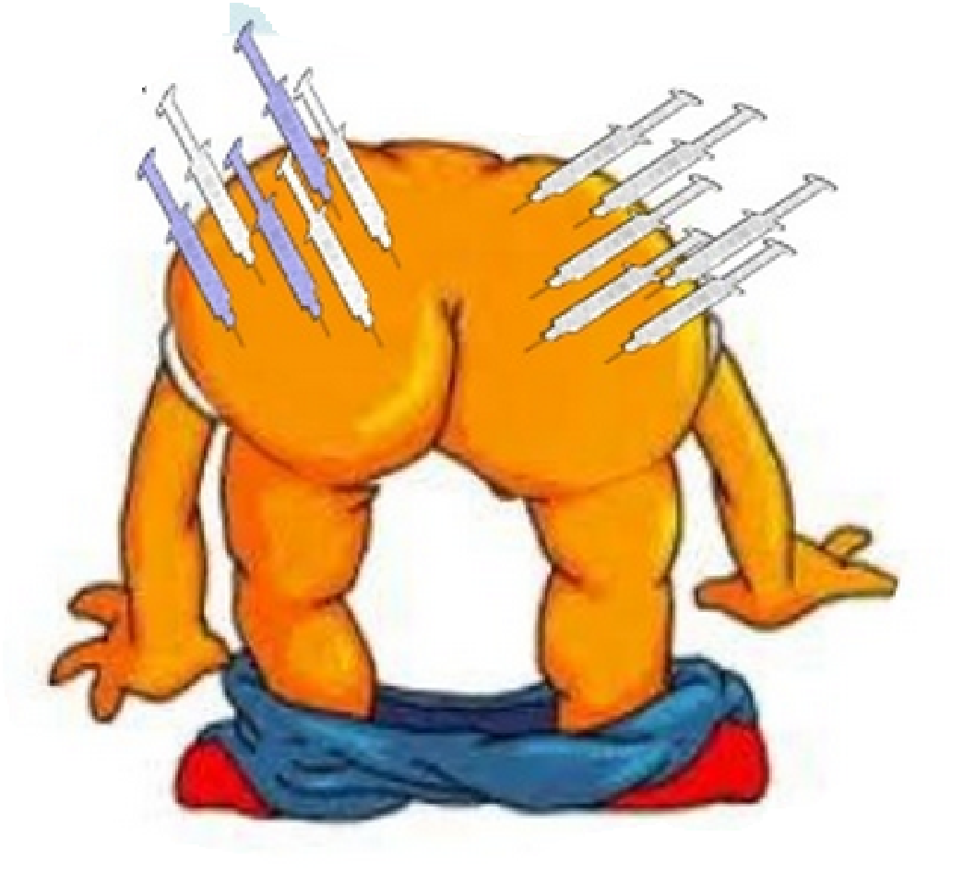
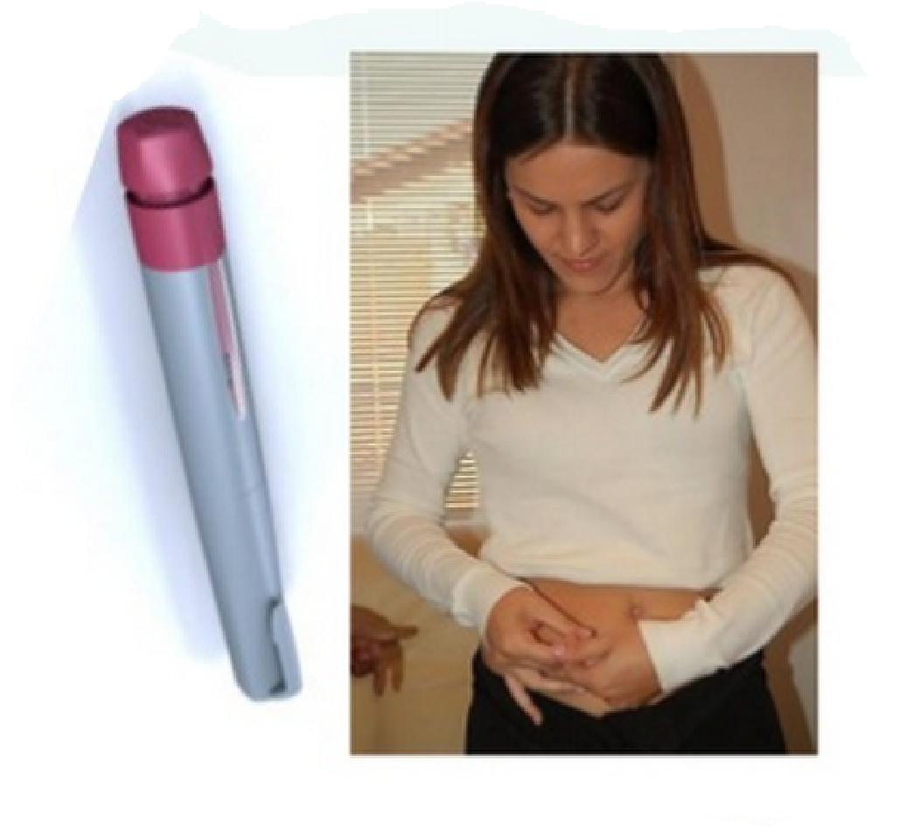
Ali …..
Zadovoljstvo pacijenata
  postoji razlika u sklonostima pacijenata nekim vrstama gonadotopina (način primjene)

Slide 33
Ali …..
Mogućnost preciznijeg doziranja pojedinih oblika lijekova
  Cochrane – nema razlike u OHSS !
Notes:
Mogućost preciznijeg doziranja je vrlo intrigantna mogućnost koja bi teoretski mogla smanjiti mogućnost OHSS-a ili odustajanja od postupka ALI COCHRANE POKAZAO DA NEMA RAZLIKE U NIJEDNOM OD TA 2 PARAMETRA. Dakle zgodna mogućnost ali da li nečemu služi ??????

Slide 34


Pitanje svih pitanja
Notes:
Ako smo zaključili da između pojedinih lijekova nema velikih razlika u učinkovitosti odnosno da su razlike najviše u načinu primjene i zadovoljstvu pacijenata, pitanje cijene će imati veliku ulogu u izboru lijekova

Slide 35
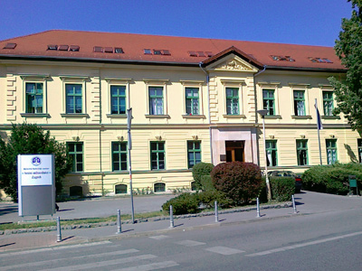
Naša iskustva
Klinika za ginekologiju i porodništvo KBC Sestre milosrdnice
Retrospektivna studija
Uključeni postupci IVF/ICSI u stimuliranom ciklusu tijekom 2013.
Nema randomizacije
Notes:
Mislim da treba komentirati studiju na način da nije randomizirana i da zato nismo ni imali ambiciju računati eventualne statističke značajnosti pojedinih trendova. U tom kontekstu možemo tek komentirati određene trendove, i opći dojam da nema bitne razlike u rezultatima pojedinih grupa. Pitanje je samo da li to komentirati na kraju ili početku serije slajdova sa našim rezultatima. Možda bolje na kraju da pojasnimo diskrepaciju nekih naših podataka i ranije iznesenih u Cochrane-u

Slide 36
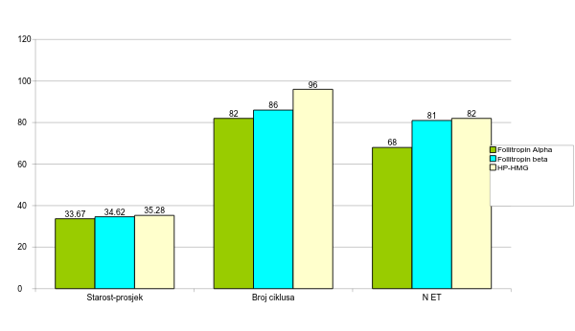
Naša iskustva

Slide 37
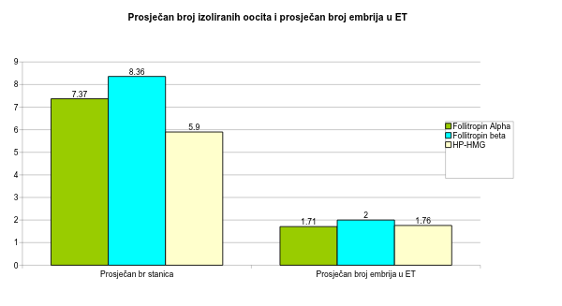
Naša iskustva

Slide 38
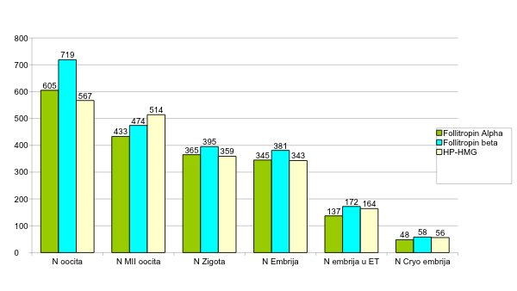
Naša iskustva

Slide 39
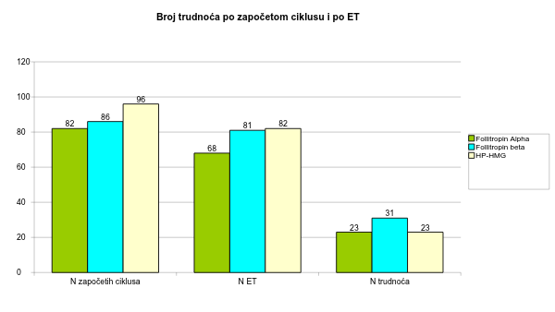
Naša iskustva

Slide 40
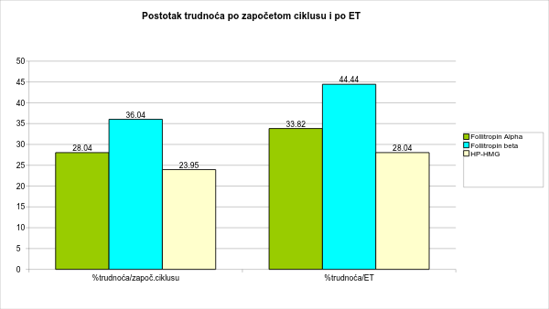
Naša iskustva

Slide 41
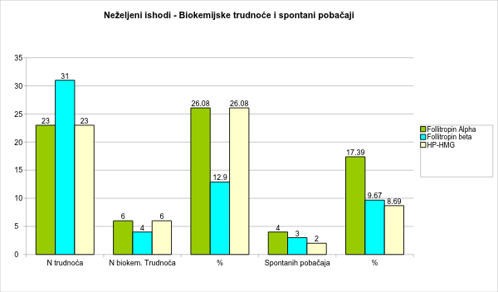
Naša iskustva

Slide 42

Hvala na pažnji

