Slide 1
Oralna kontracepcija i ginekološki karcinom
Goran Vujić

Slide 2
Evidence Reports/Technology Assessments, No. 212.
Havrilesky LJ, Gierisch JM, Moorman PG, et al.
Rockville (MD): Agency for Healthcare Research and Quality (US); 2013 Jun.
Copyright Notice
PubMed Health. A service of the National Library of Medicine, National Institutes of Health.

Slide 3
Projected ovarian cancer incidence and mortality for 2010 to 2050
2 x (15000) >40%

Slide 4
Age-specific incidence and mortality for ovarian cancera

Slide 5
Age-adjusted ovarian cancer incidence and mortality rates
- screening
- citoreduktivna kirurgija
- KTH (taxani, platina)
- < učestalost

Slide 6
Forest plot for ever versus never OC use (case-control studies, ovarian cancer incidence)

Slide 7
Forest plot for ever versus never OC use (cohort studies, ovarian cancer incidence)
OR 0,73

Slide 8
Table 7. Estimated odds ratios by duration of OC use (ovarian cancer incidence) Duration Interval Odds Ratio (95% Confidence Interval) P-Value
1–12 months 0.91 (0.78 to 1.07) 0.2504
13–60 months 0.77 (0.66 to 0.89) 0.0014
61–120 months 0.65 (0.55 to 0.77) <0.0001
>120 months 0.43 (0.37 to 0.51) <0.0001
TRAJANJE UZIMANJA KONTRACEPTIVA ZNAČAJNO
SNIZUJE POJAVNOST RAKA JAJNIKA

Slide 9
Impact of duration of OC use on ovarian cancer incidence

Slide 10
Estimated odds ratios by time since last OC use (ovarian cancer incidence) Time Interval Odds Ratio (95% Confidence Interval) P-value
0–10 years 0.41 (0.34 to 0.50) <0.0001
10–20 years 0.65 (0.56 to 0.74) <0.0001
20–30 years 0.92 (0.76 to 1.12) 0.3692
>30 years 0.79 (0.58 to 1.12) 0.1036
Smanjena učestalost u žena koje su
koristile kontraceptive u skorijem
vremenskom intervalu.

Slide 11
Forest plot for low-dose estrogen (ovarian cancer incidence)
< 35 mcg estradiola

Slide 12
Forest plot for high-dose estrogen (ovarian cancer incidence)
0,55 VS. 0,62 NS

Slide 13
Forest plot for high-dose progestin (ovarian cancer incidence)
OR 0,55

Slide 14
Forest plot for low-dose progestin (ovarian cancer incidence)
0,55 vs. 0,81 n.s.

Slide 15
Forest plot for BRCA1 or BRCA2 carriers (ovarian cancer incidence)
0,58 vs. 0,65 n.s.

Slide 16
Data for ovarian cancer mortality
Studya Study Details OR 95% CI
Cohort
Survival After Diagnosis of Ovarian Cancer
Nagle, 2008167
Exposed: 310 women
Unexposed:366 women 0.88 0.70 to 1.11
Population-Level Mortality
Hannaford, 201033 Royal College General Practitioners Oral Contraceptive Study
Exposed: 28,806 women
Unexposed: 17,306 women 0.53 0.38 to 0.72
Vessey, 2010165 Oxford Family Planning Association contraception study
602,700 person-years of observation for unexposed and exposed
0.87 0.79 to 0.96
OR 0,53-0,88

Slide 17
Forest plot for ever versus never OC use (case-control studies, breast cancer incidence)
OR 1,08

Slide 18
Estimated odds ratios by duration of OC use (breast cancer incidence) Duration Interval Odds Ratio (95% Confidence Interval) P-Value
0–12 months 0.95 (0.83 to 1.09) 0.465
13–60 months 1.03 (0.92 to 1.15) 0.644
61–120 months 1.01 (0.90 to 1.13) 0.895
>120 months 1.04 (0.93 to 1.17) 0.457
0,95-1,04 N.S.

Slide 19
Forest plot for ever versus never OC use (case-control studies, cervical cancer incidence)

Slide 20
Estimated odds ratios by duration of OC use (cervical cancer incidence) Duration Odds Ratio (95% Confidence Interval) P-value
< 60 months 0.99 (0.58 to 1.70) 0.975
> 60 months 1.47 (0.91 to 2.38) 0.097

Slide 21
Table 29. Study characteristics and association between OC use
and cervical cancer mortality Study
Cohort
Hannaford, 201033
Royal College of General Practitioner’s Oral Contraception study
Exposed: 28,806
Unexposed: 17,306
Mean age at entry: 29 yr (SD 6.6)
Recruitment period: 1968–1970 1.34 (0.74 to 2.44)
Vessey, 2010
Oxford Family Planning Association Contraceptive Study
602,700 person-yr (total for exposed and unexposed)
Recruitment period: 1968–1974 7.3 (1.2 to 305.0)

Slide 22
Forest plot for ever versus never OC use (case-control and pooled studies, colorectal cancer incidence)
OR 0,86

Slide 23
Estimated odds ratios by duration of OC use (colorectal cancer incidence)
Duration Odds Ratio (95% Confidence Interval) P-value
< 60 months 0.88 (0.77 to 1.01) 0.063
> 60 months 0.88 (0.76 to 1.01) 0.061
NS

Slide 24
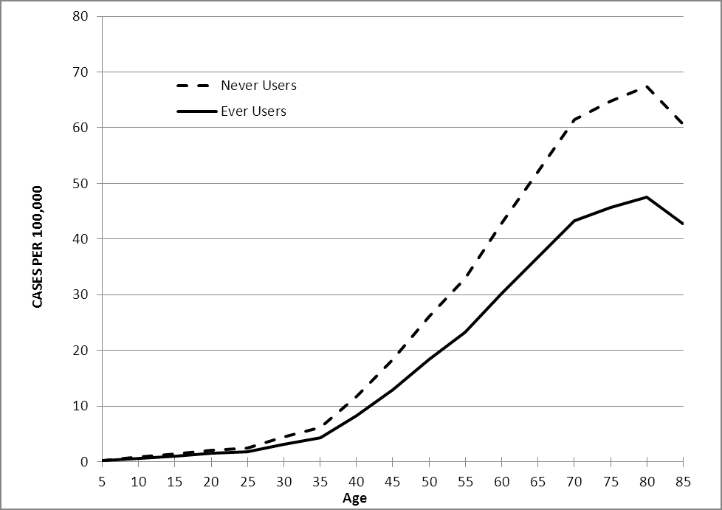
Estimated age-specific incidence of ovarian cancer among ever versus never OC users
< 20

Slide 25
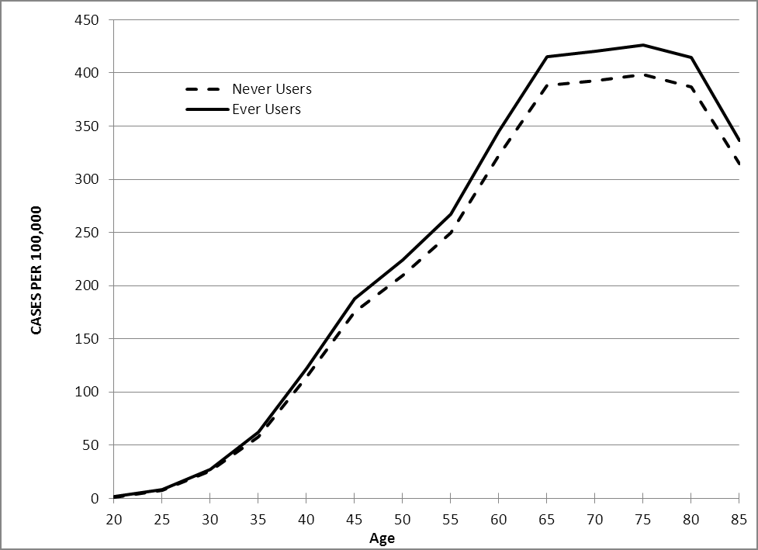
Estimated age-specific incidence of breast cancer among ever versus never OC users
> 45

Slide 26
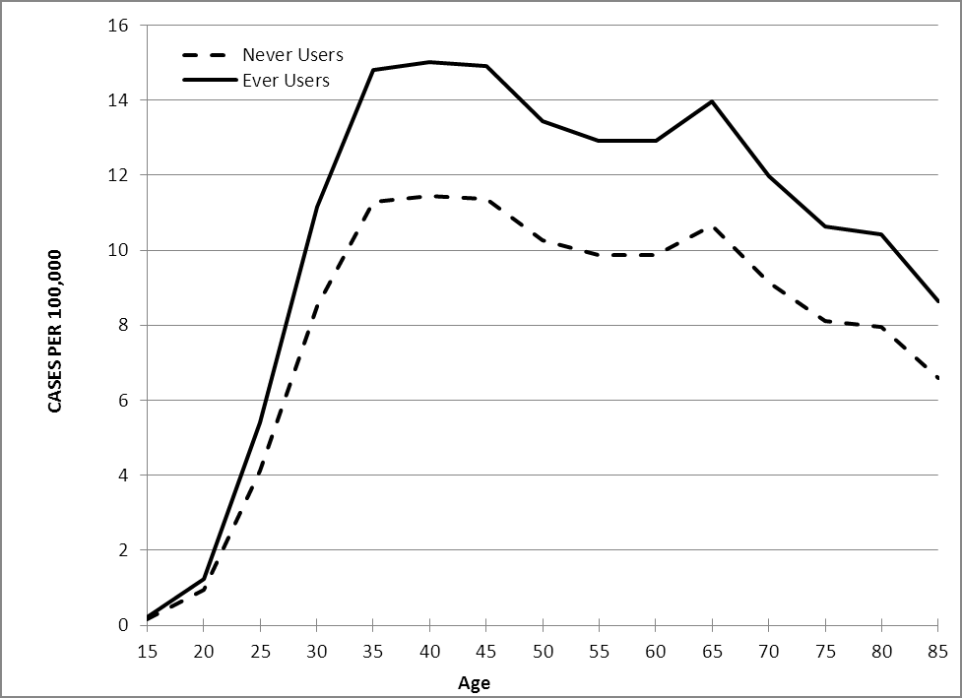
Estimated age-specific incidence of cervical cancer among ever versus never OC users
> 4

Slide 27
Estimated age-specific incidence of colorectal cancer among ever versus never OC users
< 50

Slide 28
Estimated age-specific incidence of endometrial cancer among ever versus never OC users
<60

Slide 29
Increase in age-specific incidence of vascular events in current OC users versus noncurrent users

Slide 30
Increase or decrease in age-specific incidence of cancers in ever OC users versus never users

Slide 31
zaključno
ZNAČAJNO SMANJENA UČESTALOST RAKA
  JAJNIKA OR 0,73
  DEBELOG CRIJEVA OR 0,86
  ENDOMETRIJA OR 0,57
BLAGO ALI ZNAČAJNO POVIŠENA UČESTALOST
  DOJKE OR 1,08
  VRATA MATERNICE (HPV POZ.)

Slide 32
ORALNA KONTRACEPCIJA NIJE METODA IZBORA U PREVENCIJI GINEKOLOŠKIH KARCINOMA PA NITI VISOKORIZIČNIH SKUPINA (BRCA 1,2) AKO SE UZMU U OBZIR NEGATIVNI UČINCI NA KARDIOVASKULARNE BOLESTI, POJAVNOST RAKA DOJKE I RAKA VRATA MATERNICE U ŽENA SA HPV INFEKCIJOM

Slide 33
